Slide 1
Computerized Adaptive Test System
Submitted by : Md. Khairul Alam
Roll : BSSE1118
Supervisor : Prof. Dr. Zerina Begum

Slide 2


What is a CAT?
Is it me?

Slide 3
Definition of CAT
Computer Administered Test
Adapts to the examinee’s ability
3. Next item is selected by examinee’s responses

Slide 4
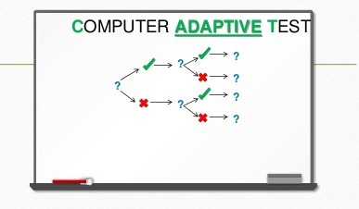
Visualization of CAT

Slide 5
Proposal Of SPL-1
The program will consist of a user interface and a backend which contains some specific set of questions on one topic or various topics.
Depending on the user’s performance at answering, the program will evaluate the user and change the question set according to the user’s skill. Here the questions set will be selected by implementing a Computerized Adaptive Test (CAT) algorithm (either Rasch Algorithm or Monte Carlo Algorithm).
Finally the grade/performance of the user will be displayed.

Slide 6
Motivation of The Project
Provide important measurement of advantages
Higher engagement of students
Lower anxiety
Remove Depression of students

Slide 7
Project Steps
Make question sets according to the difficulty level.
Questions will stored in file
There will be easy , medium , hard and super hard question.
Read files and randomly take a question
By the response nest question will be generated

